Slide 1
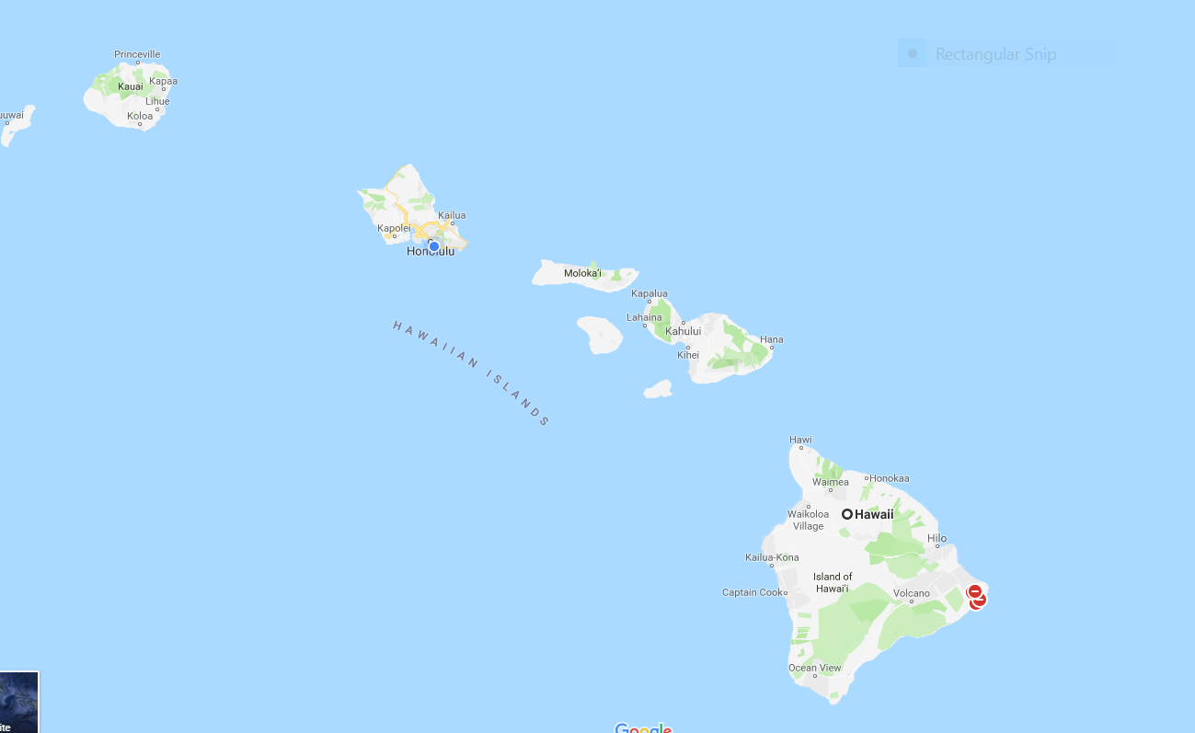
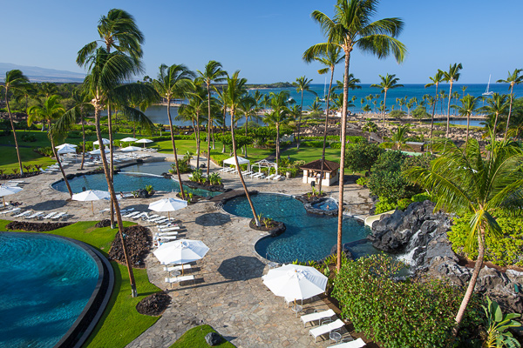
Aloha
Hawaii
May 26 to May 28, 2022
Waikoloa Beach Marriott Resort

Slide 2
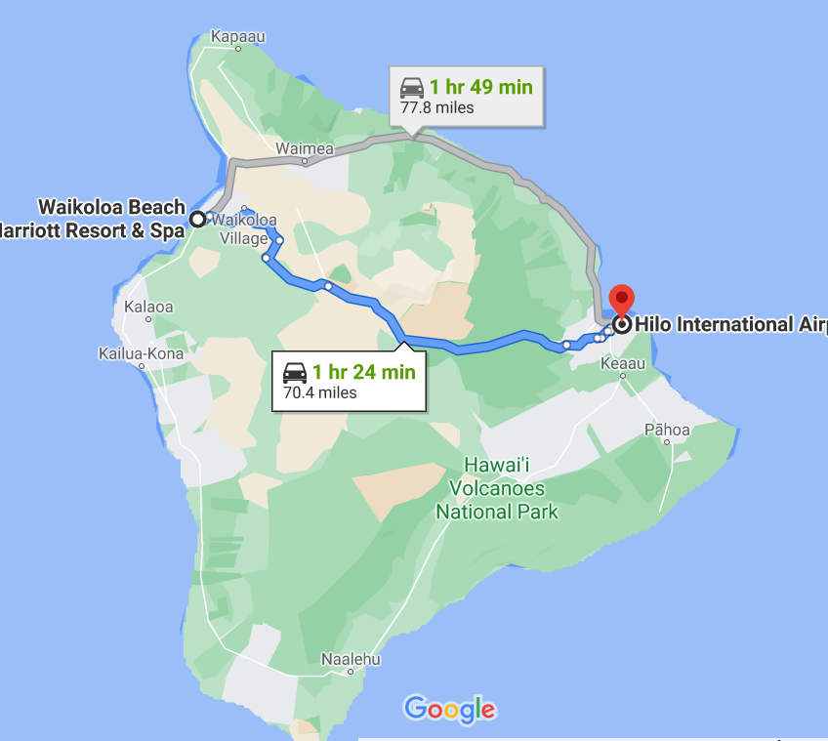
Where do I fly into?
Kona International is 20 minutes from resort
Hilo International is 1 hr 25 from resort
Or Honolulu and take short Hawaiian air flight over
Should I rent a car?
While at conference you won’t need a car –restaurants, Groceries and shopping very nearby
If you want to site see before or after – rent a car – book before arrival & check discount rates at hotel
Parking at hotel is $21 self $31 valet daily
Kona International
Kona airport
Shuttles and UBER are available

Slide 3
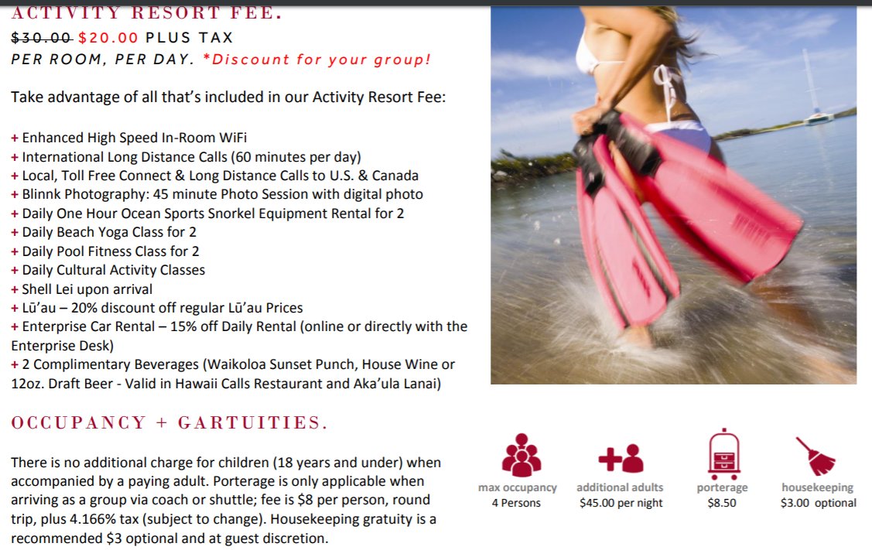
Optional This is good deal
Eg internet is $14.95 per day

Slide 4
Resort Fee
The resort fee is optional.
You will be asked at check in – if you want it – YES or NO
If you choose the resort fee it will be applied for every night that you stay
If you choose not to get it but then decide that you are staying on a couple of extra days after the conference and now have time to do activities – you can go to desk and add it on and it will be added to your room for the rest of your stay.
You can buy just internet for your room or internet is free in some of the public places.

Slide 5
Room Rates
Resort View $220 S/D
Pool View $230 S/D
Ocean View $275
Ocean Front $295
Some types of rooms will sell out
Also indicate under requests on web if you want one or two beds
$45 + 14.962% tax per 3rd & 4th adult person occupying one room
How many rooms do you expect will use dbl/dbl. I’d like to be sure we have those set aside
The hotel will probably sell out quickly. We suggest you book NOW –
You can cancel up to 7 days before arrival
Go to NASPSPA website and look under Conferences 2022

Slide 6
Current Rates on Web
Hotel Room reservations are open
Make sure you book ASAP!

Slide 7
Read carefully
NASPSPA SLEEPING ROOMS ARE NOW OPEN FOR RESERVATIONS
The primary conference will start on Thursday morning, May 26, 2022 and end with dinner on Saturday evening, May 28th. There are some rooms available before and after the conference dates. To make your reservation go to this link.
https://book.passkey.com/go/NASPSPA2022
At the bottom of the reservation page it says additional requests. Please indicate if you would prefer one or two beds. The hotel will do the best they can to fulfill your request.
You may also call in their reservation to: 1-877-622-3140
Marriott Agents are happy to assist them your reservation.
Should they call in, please have them mention that they are booking a
“Passkey room” for NASPSPA at the Waikoloa Beach Marriott.
All Marriott reservations are taken at this number and mentioning the above will help them to be efficient in locating your website and special rates.

Slide 8
Looking forward to seeing you at future conferences and at the NASPSPA conference hotels!

